Slide 1
Breast Cancer prediction with the CAMELYON16 dataset
COMS4995 Applied Deep Learning
Xiaoling Pang(xp2185), Mingxi Zhu(mz2839)

Slide 2
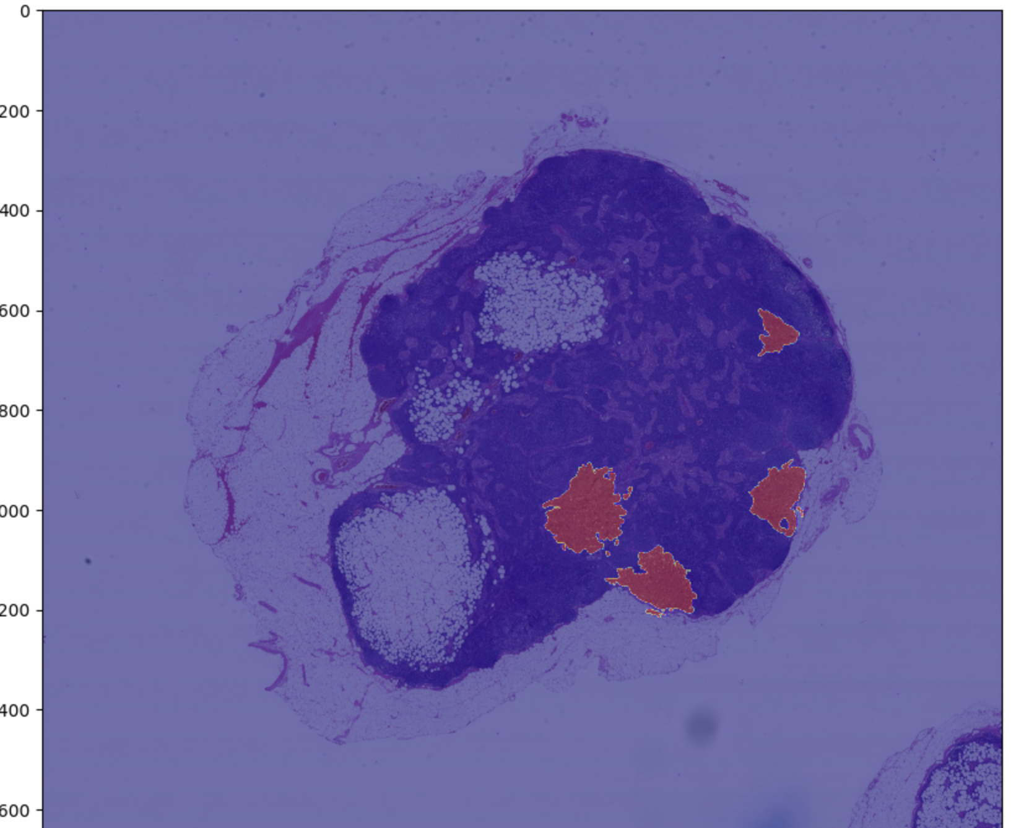
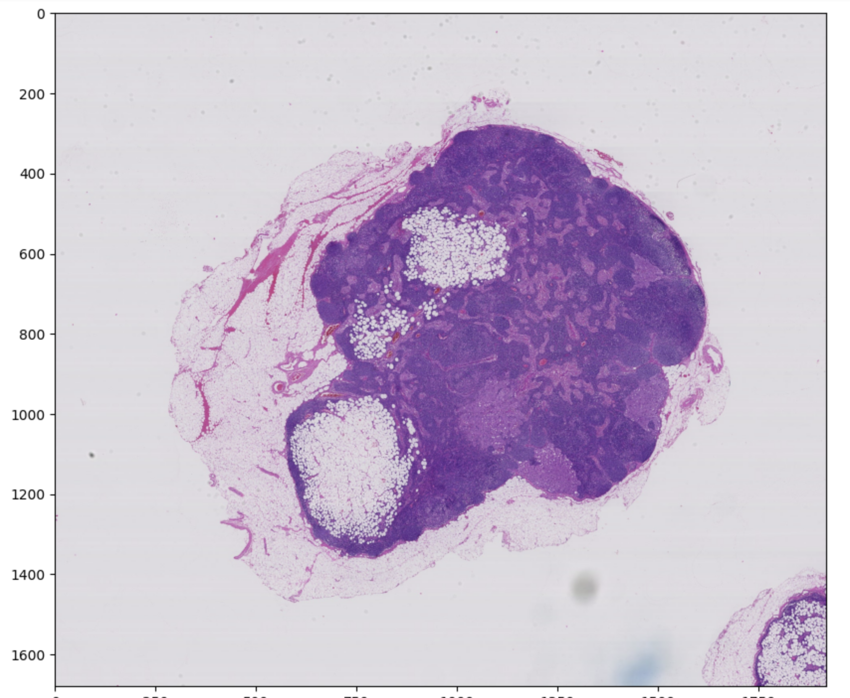

Build a Deep Learning Model to detect tumor tissues

Slide 3
Outline
Data
Preparation
Preprocessing
Creating database
Model
Base model
Transfer model
Result and Future Improvement
Heatmap showing the result
Future Improvement

Slide 4
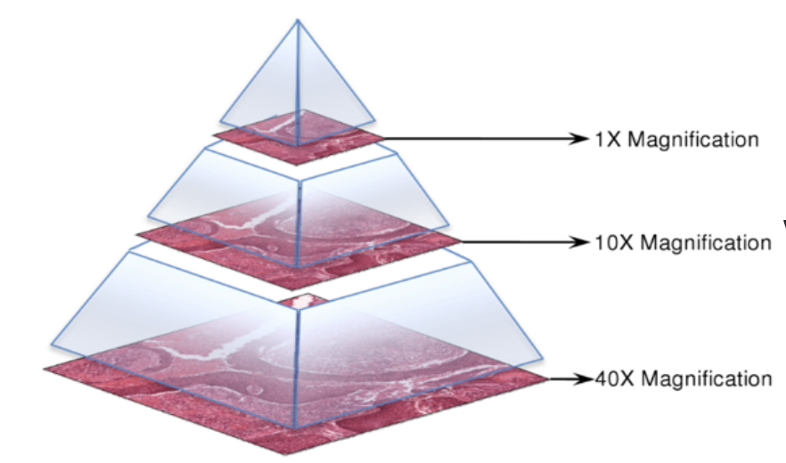
Introduce our data
Data set for the project
https://camelyon17.grand-challenge.org/Data/
Samples we used in this project:
Train the model: Tumor_016 & Tumor_091
Prediction: Tumor_110
Whole-slide images of sentinel lymph node stored in multi-resolution pyramid
collected from medical centers
Corresponding Whole-slide images of binary mask annotated by expert pathologists

Slide 5
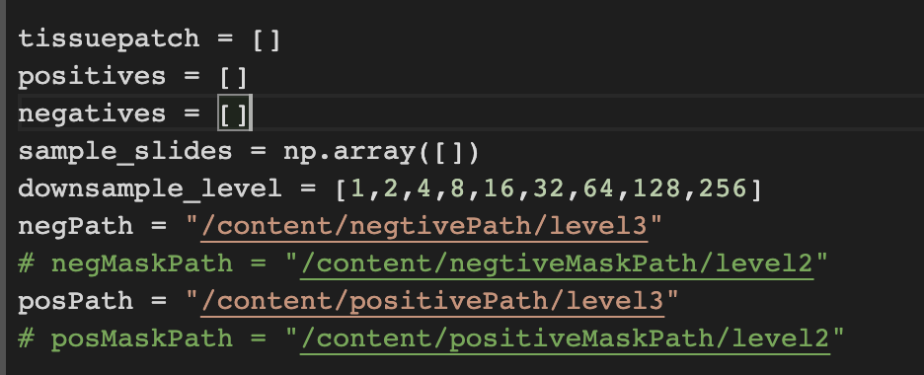
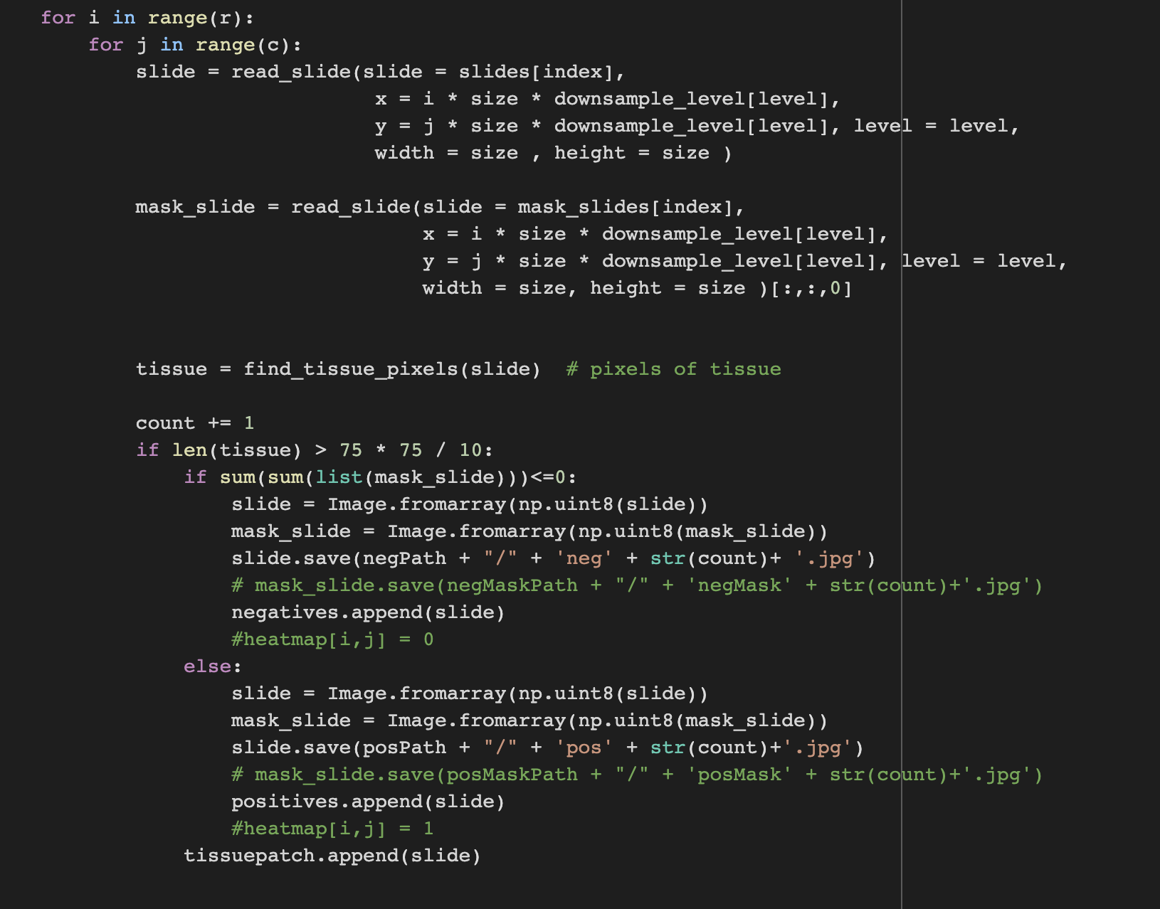
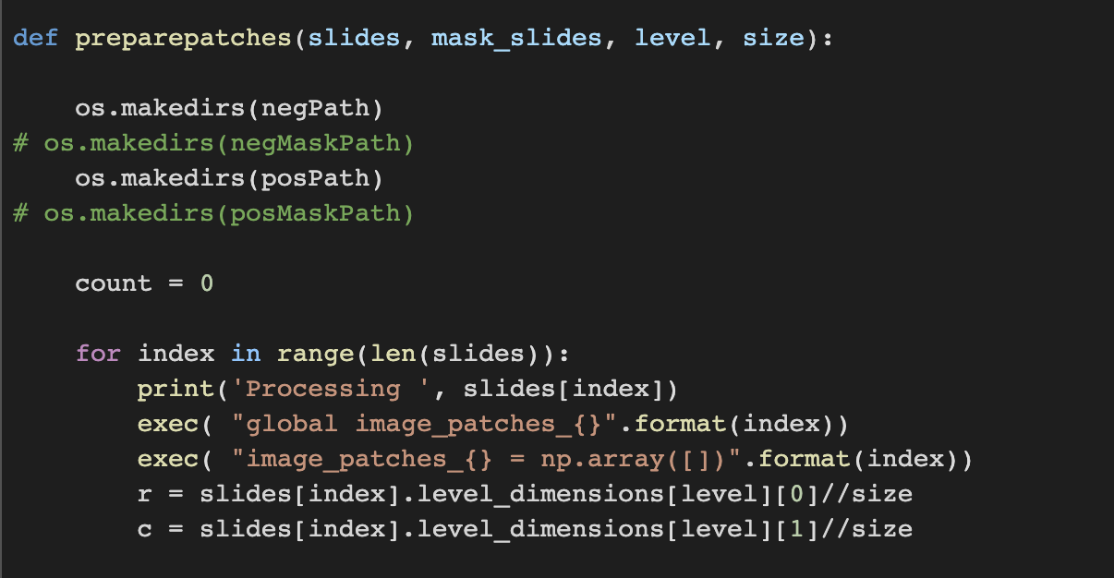
Data Preparation

Slide 6
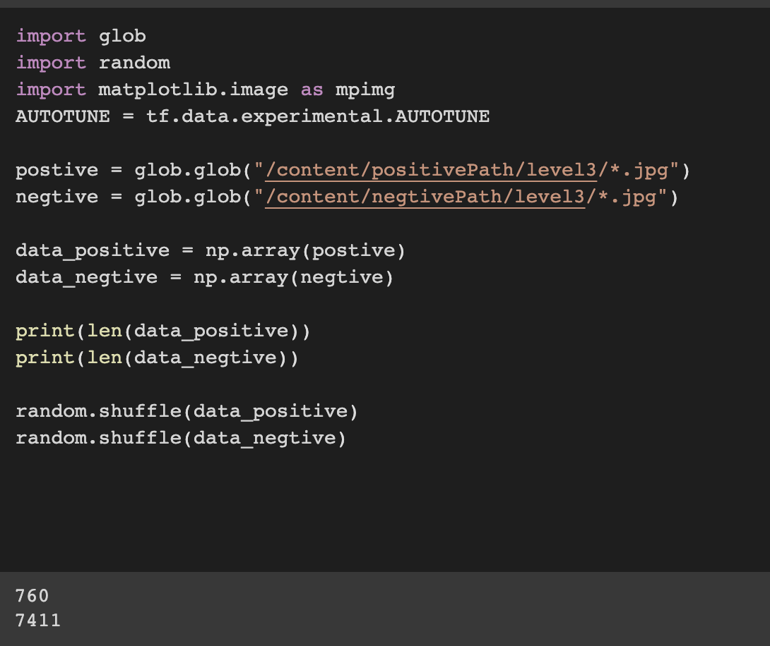
Data Preparation
The number of negative patches is far more than the number of positive patches
Data Augmentation
Imbalanced data set

Slide 7
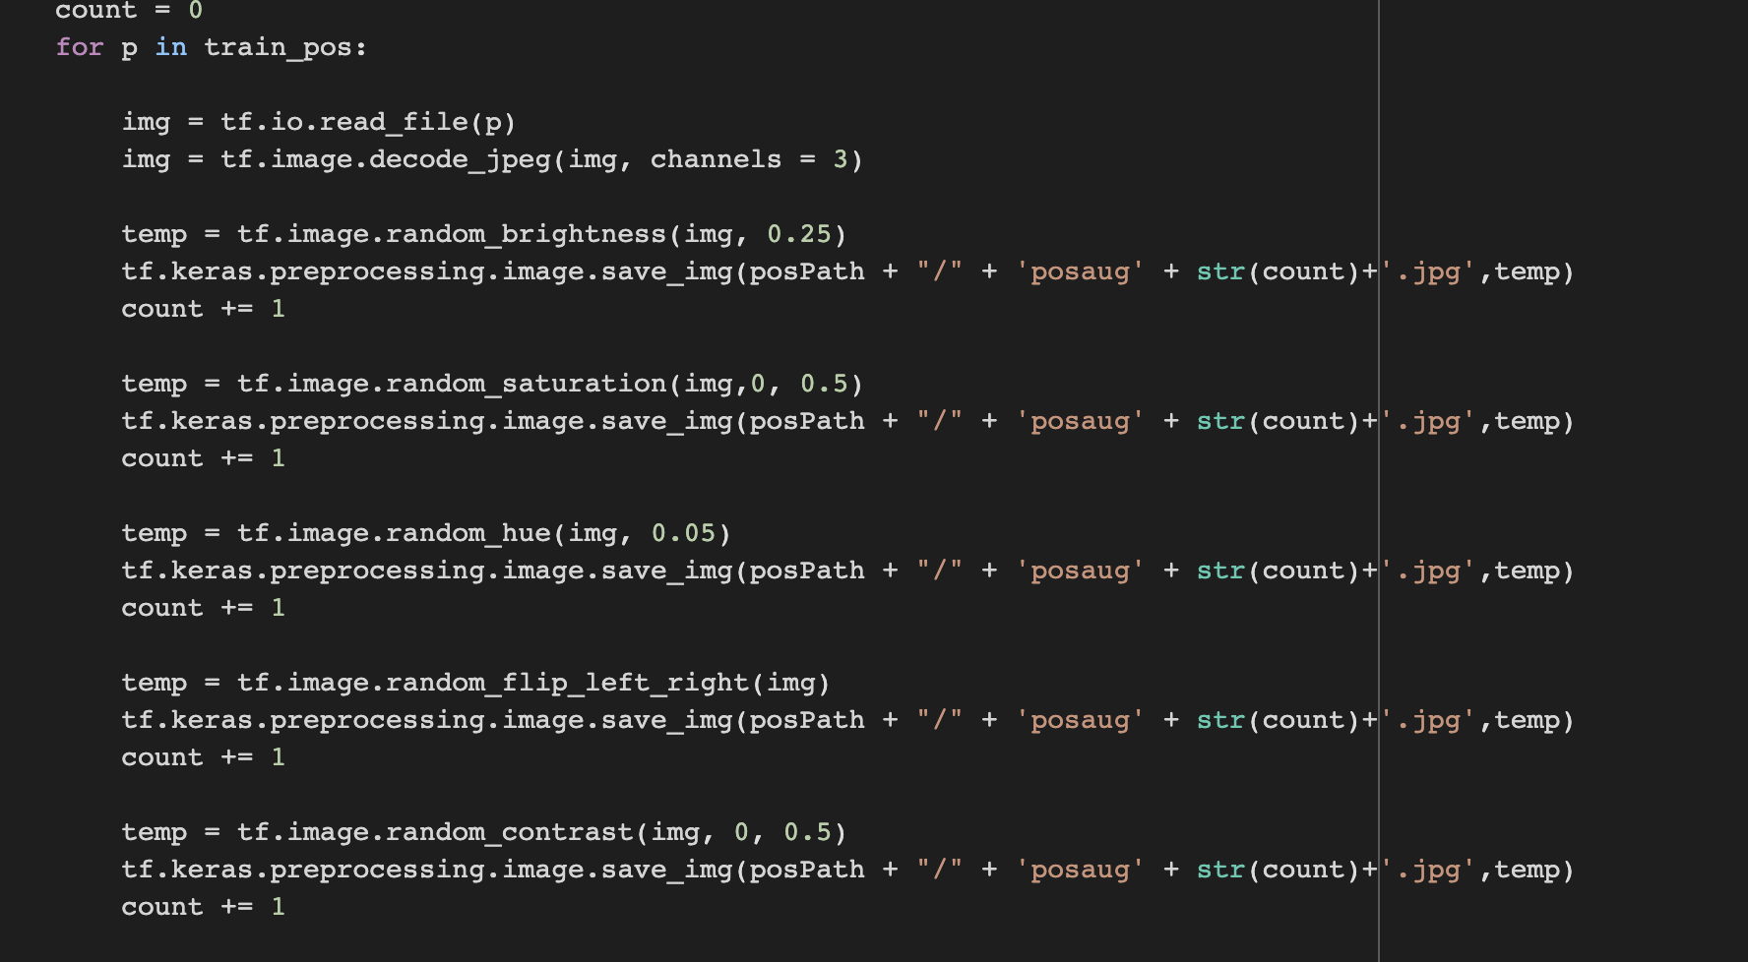
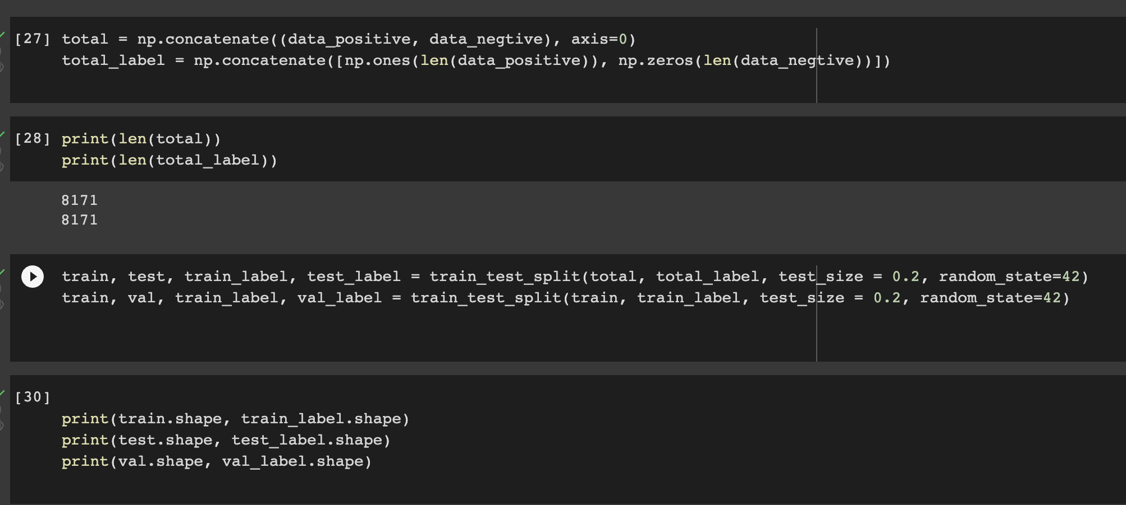
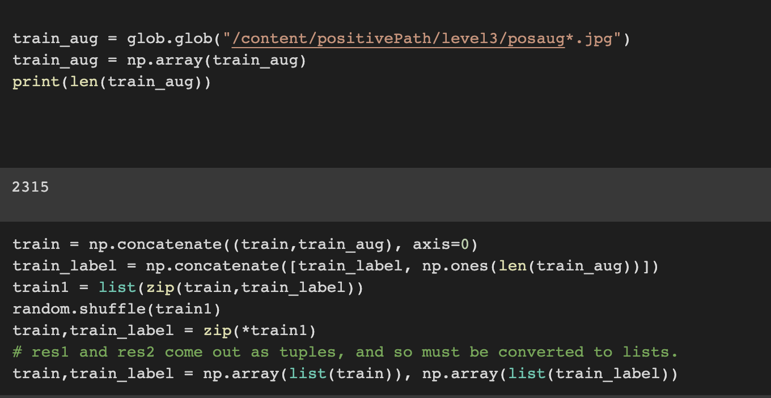
2) Augment the training set
Data Augmentation
Data Augmentation
Create training and test data set
Create training and test set

Slide 8
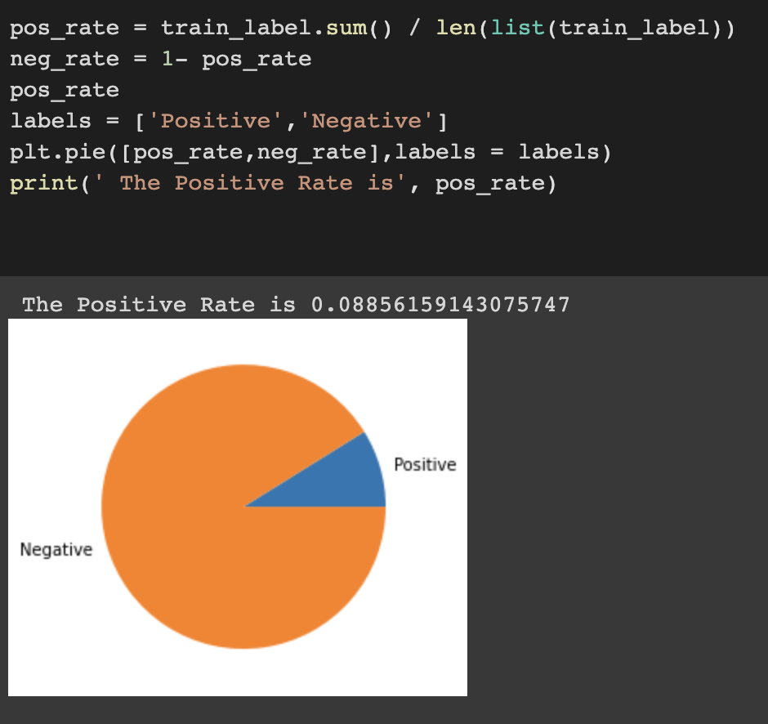
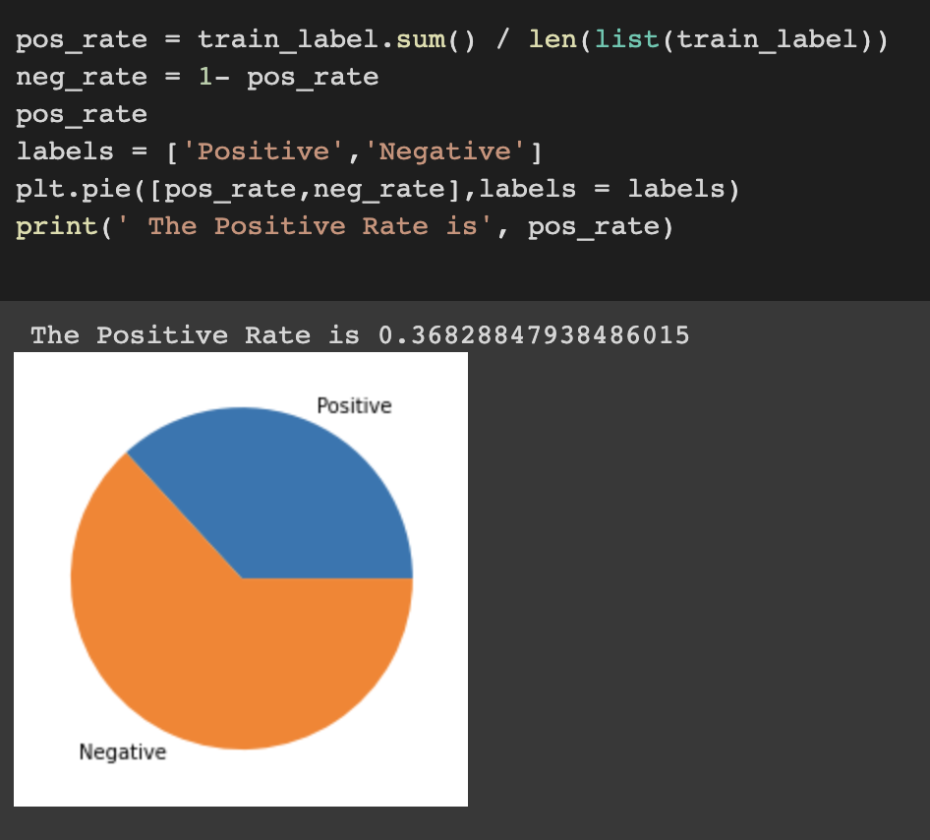
How data augmentation works
Before augmentation: positive rate is 0.089
After augmentation: positive rate is 0.37

Slide 9
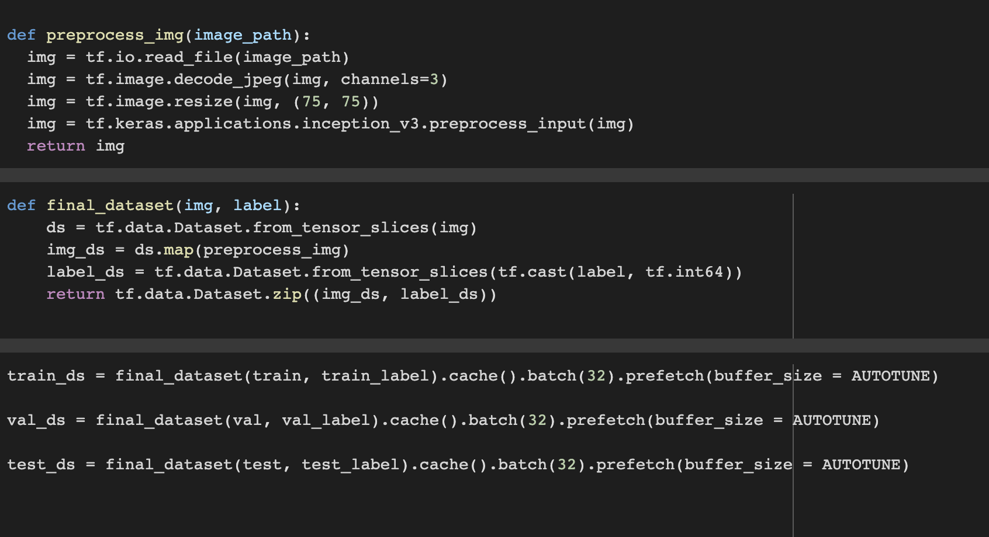
Create the final dataset
Change the format of our image data so that it can be accepted by models

Slide 10
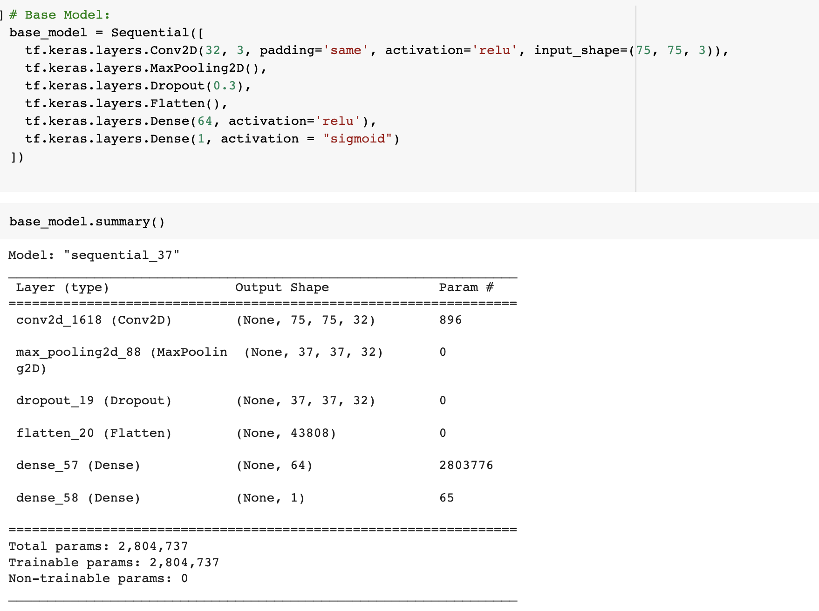
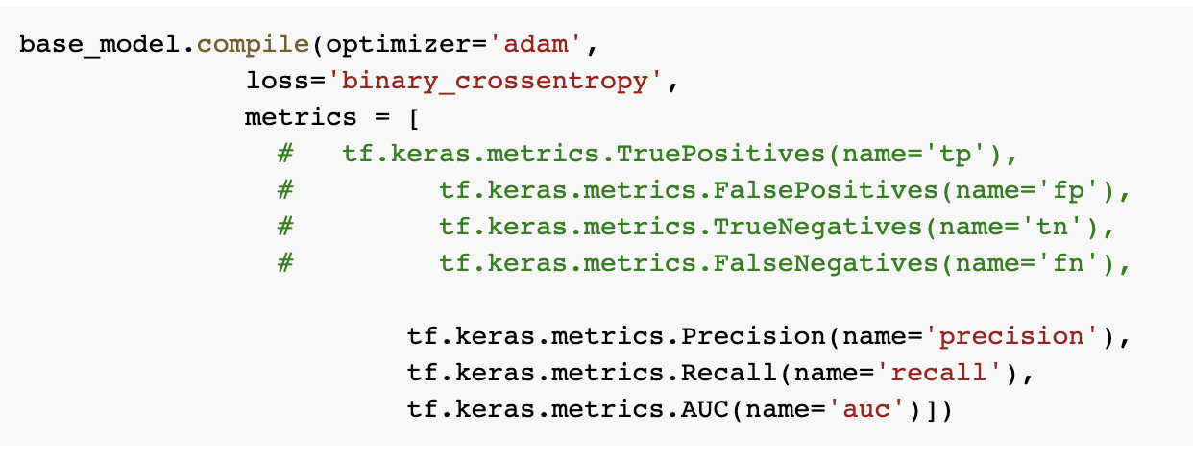
Models
Self-defined Base Model:

Slide 11
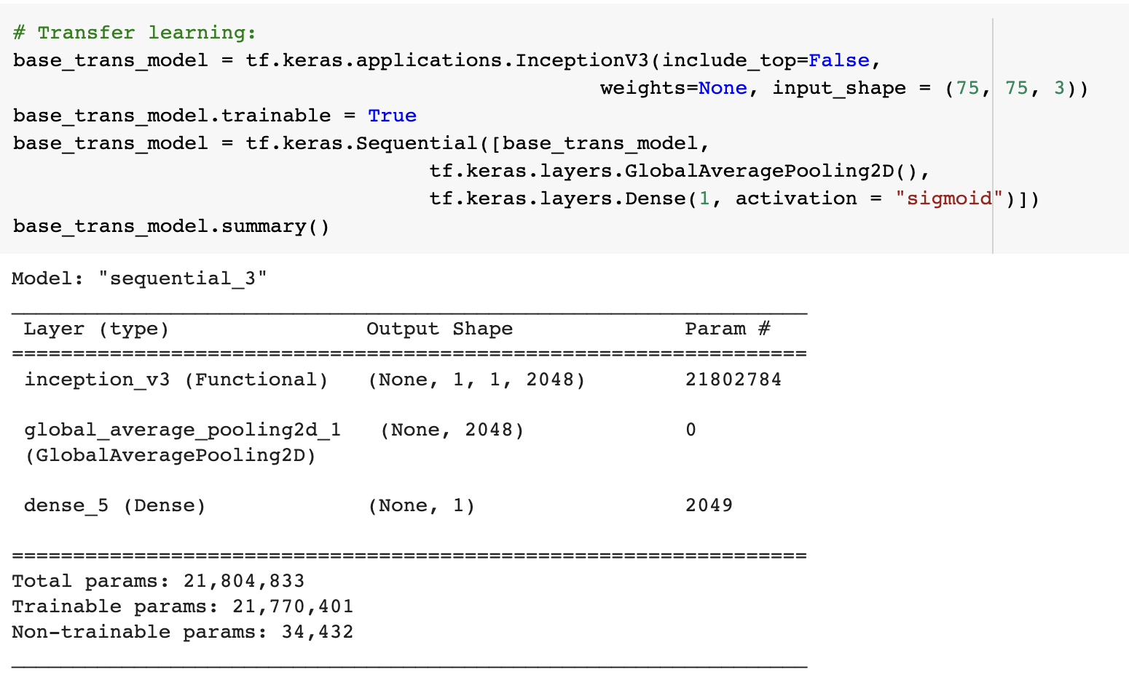
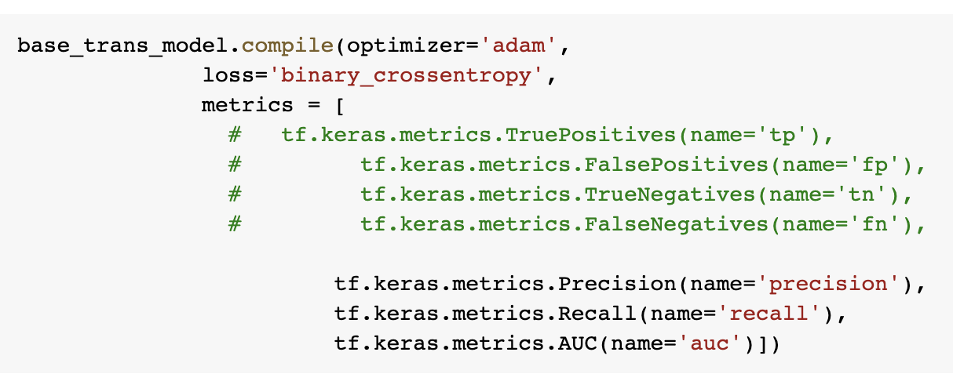
Models
Transfer learning model using InceptionV3

Slide 12
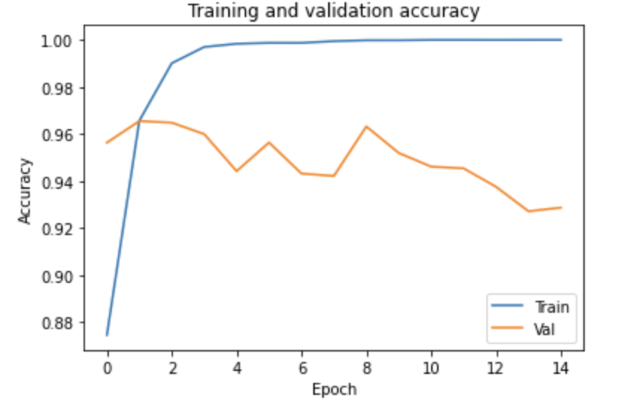
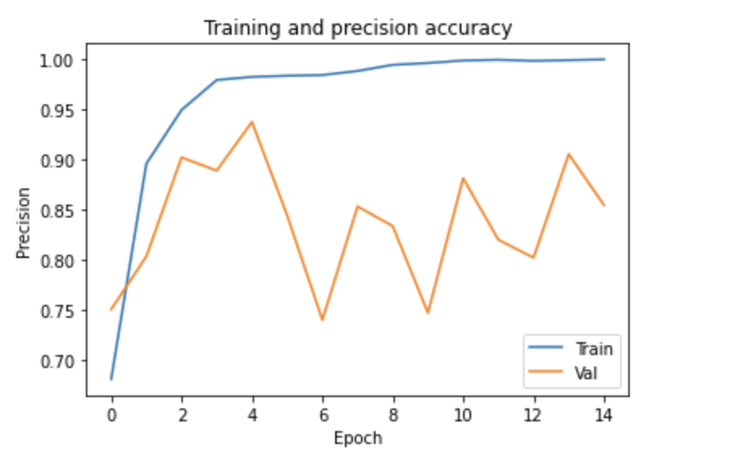
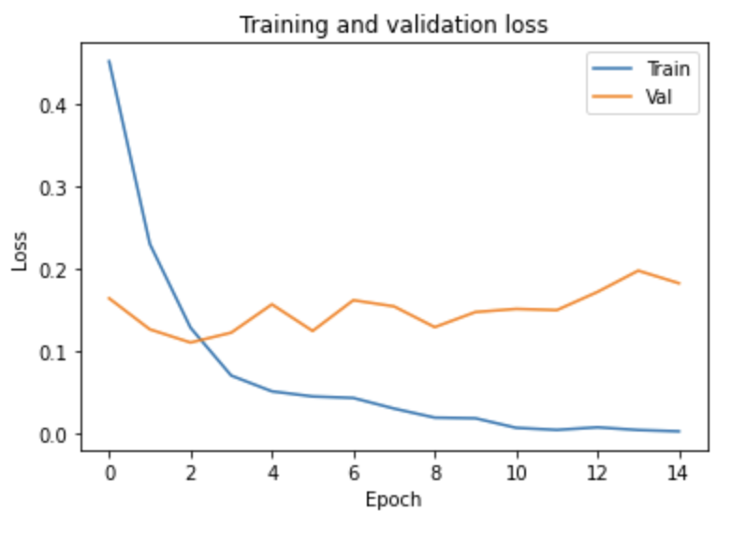
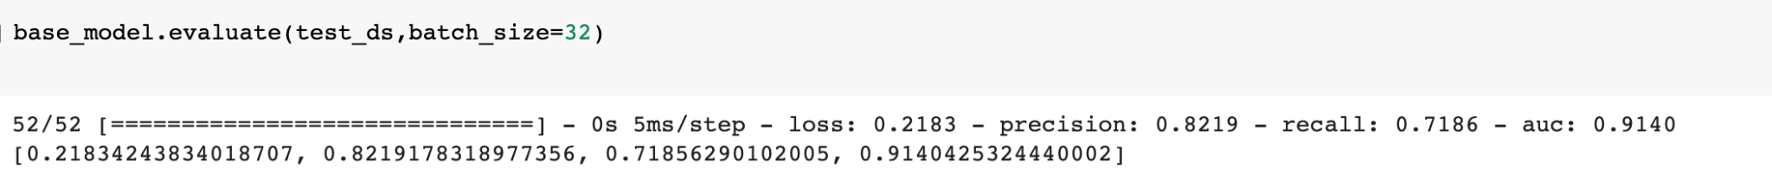
Performance of the base model (Level 3)
Test set evaluation:

Slide 13
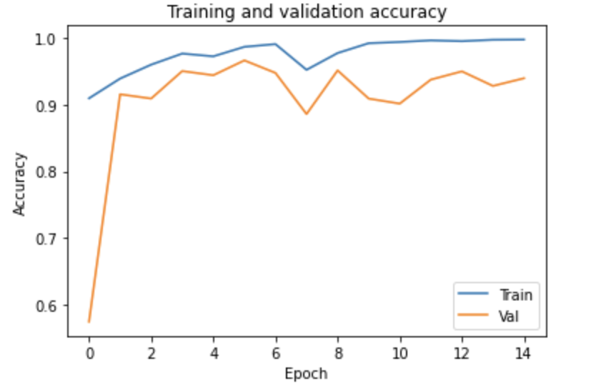
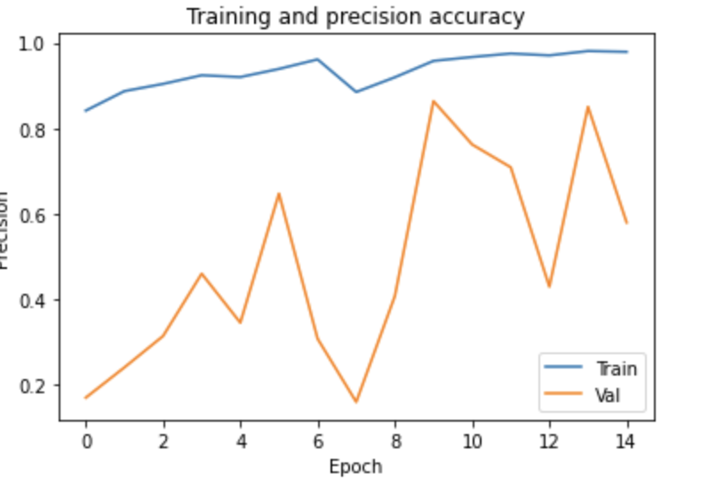
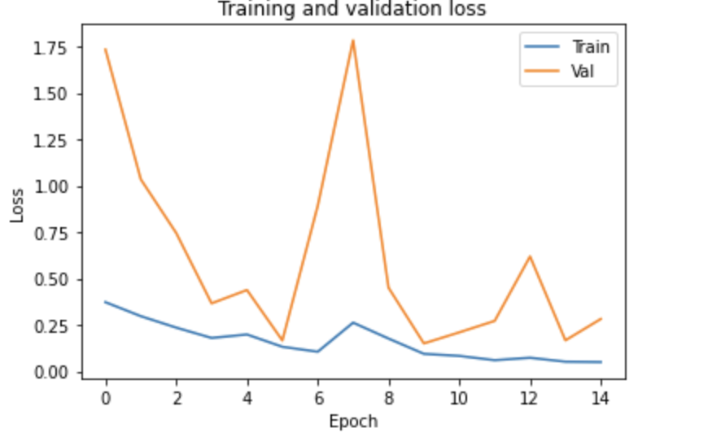
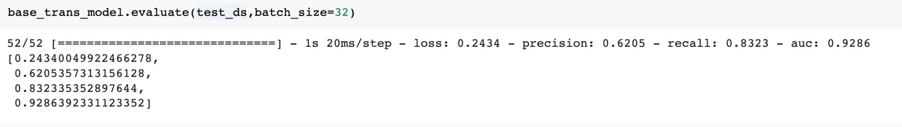
Performance of the Transfer learning model (Level 3)
Test set evaluation:

Slide 14
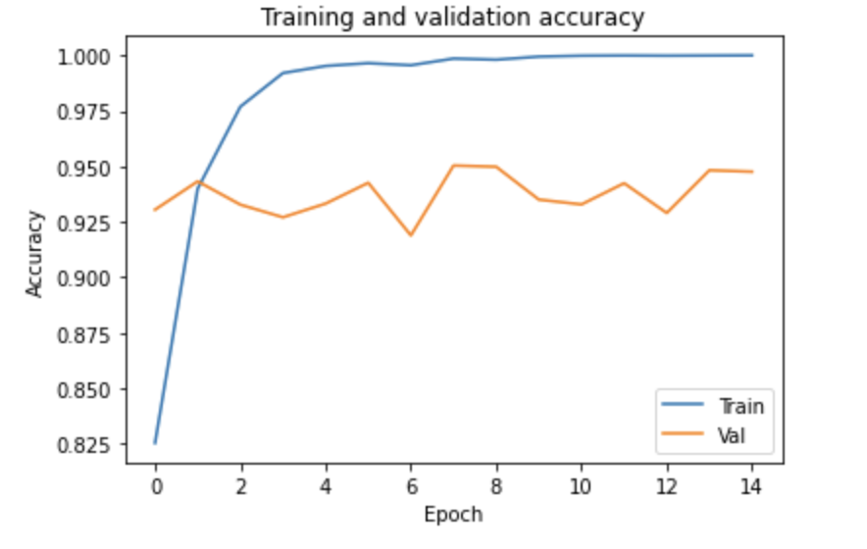
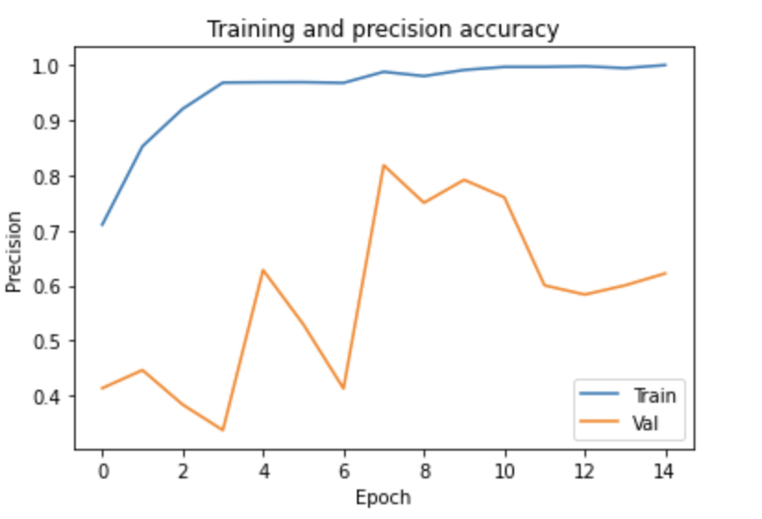
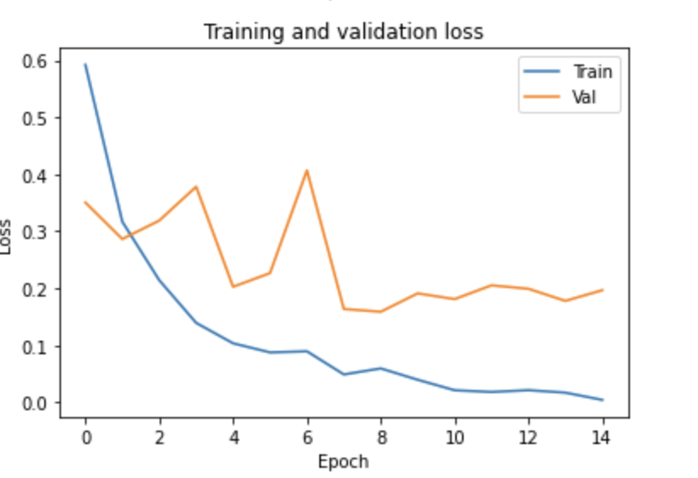
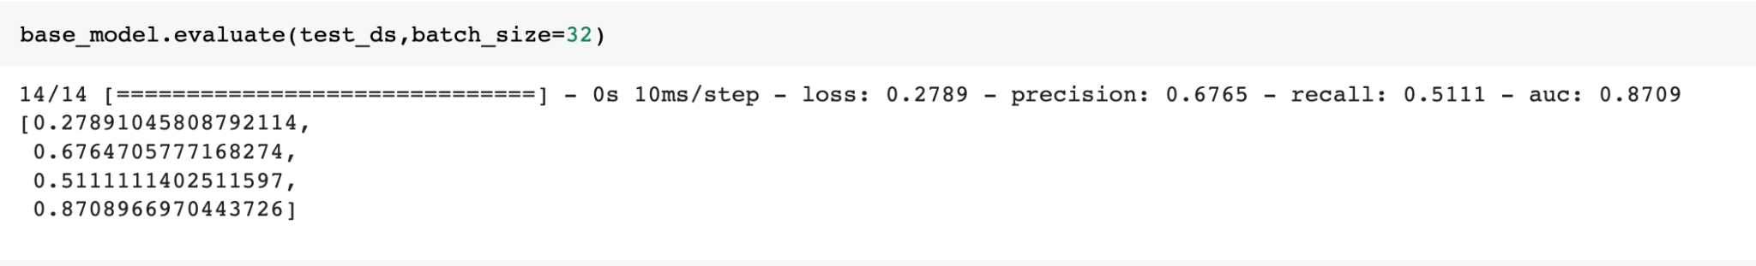
Performance of the base model (Level 4)
Test set evaluation:
Notes:
Explain the code for level 4 using colab, then come back to the performance

Slide 15
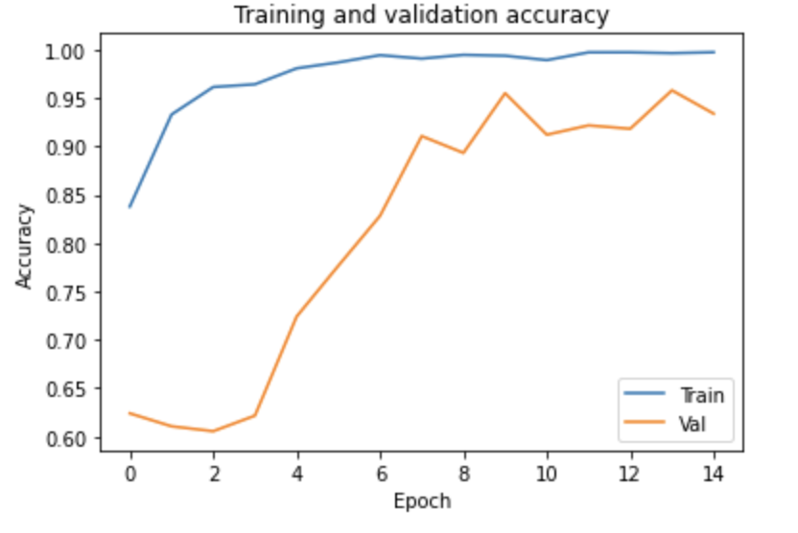
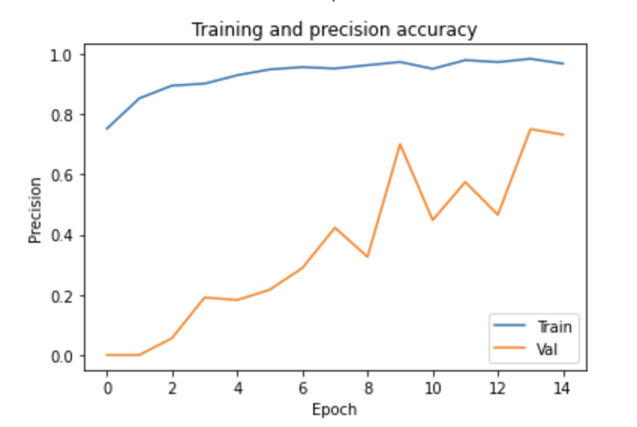
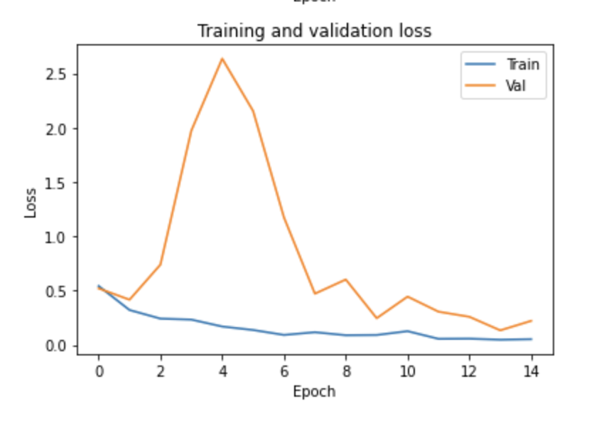
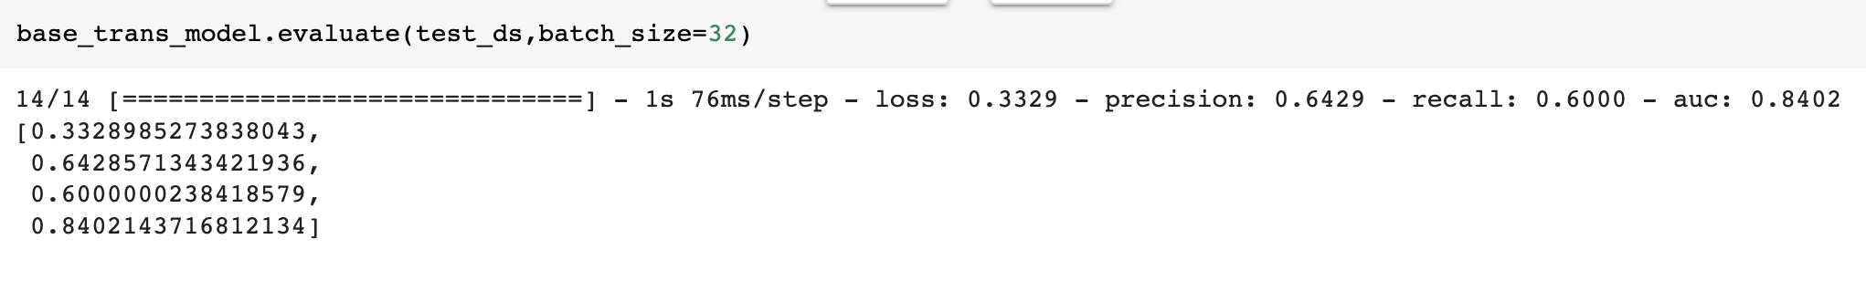
Performance of the Transfer learning model(Level 4)
Test set evaluation:

Slide 16
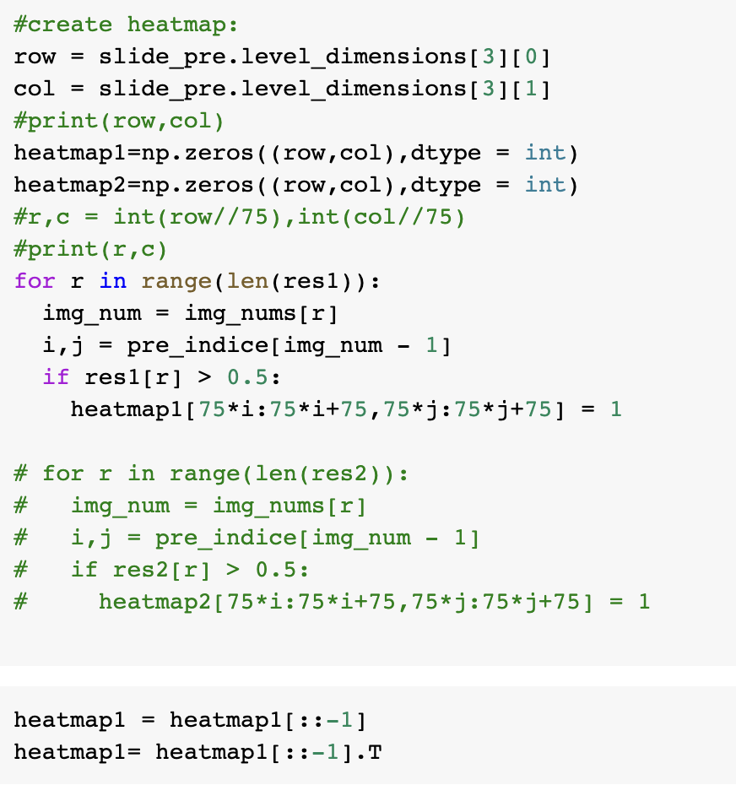
Result-Heatmap
According to the performance metrics，the base model trained by level3 gives the highest accuracy and lowest loss.
We use this model to predict the tumor part of the tumor_019

Slide 17
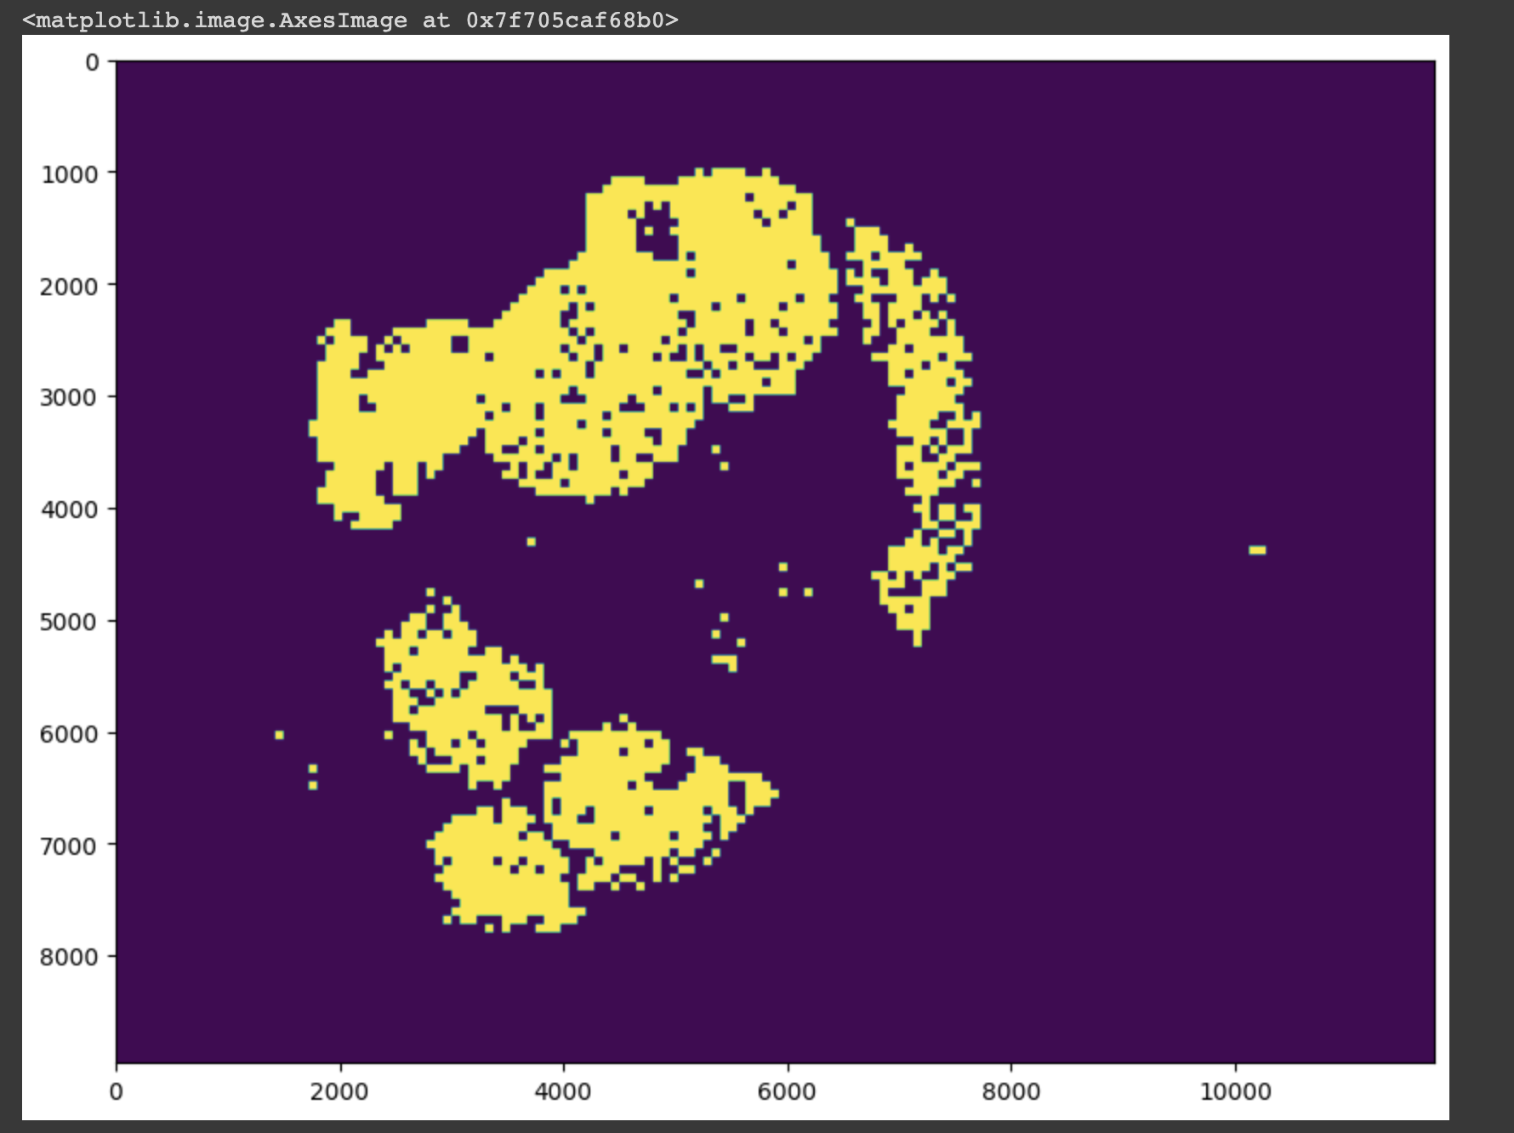
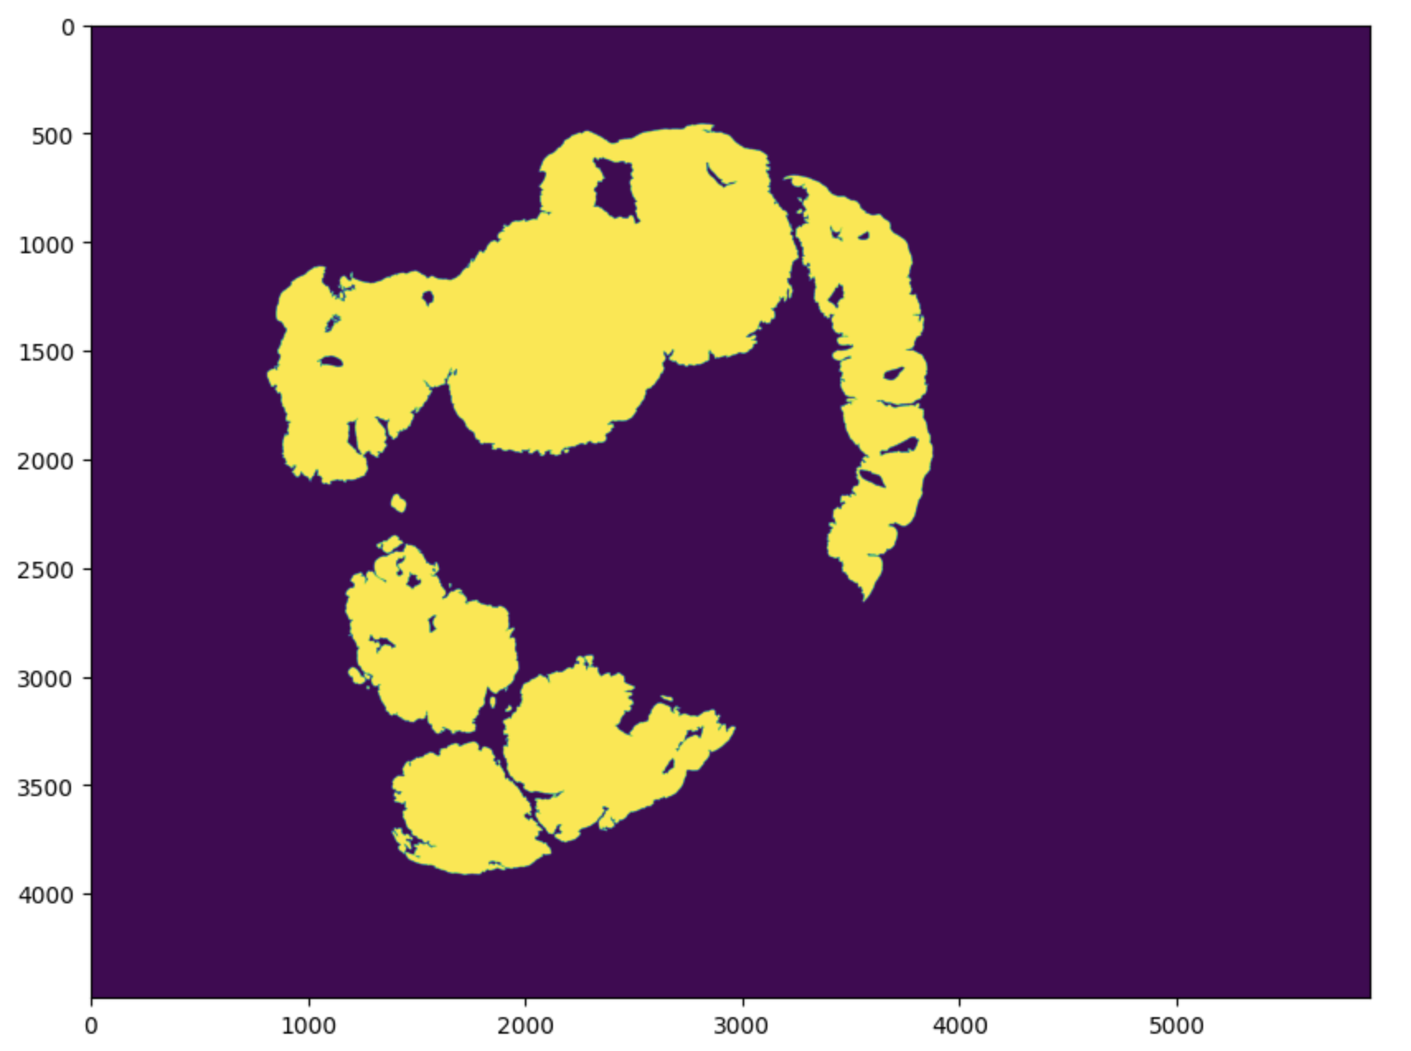
Heatmap – tumor_110.tif
Prediction
Reality

Slide 18
For future
More levels of samples
Ensemble methods
Other techniques other than patch-wise
Different batches
Different Learning rate

